Slide 1
CarRepair – E-servicebook
Made by :Hollander Norbert, Nagy Zsolt,Németh Máté

Slide 2
Task
CarRepair wants to create a platform where visitors can register and report their cars for service online. They can then view the work already done per car as an electronic service book.
The task is to create a website and mobile app where visitors can register to the car service database, where they can register their cars to their fleet along with their own data, and then manage this fleet by cancelling or registering for service. They can retrieve the service history of each car from the fleet, like in an electronic service book.
The data should be stored in an online database that can be accessed via an API. The web pages or mobile application created will download and display the data from this API.
In addition to the user interface, there is also an administrator interface, which is not available separately from the login area, but by entering the username and password you are redirected to another interface where you can view, delete or fill in the worksheets of the logged-in cars. There is also a tab where all the worksheets are displayed.

Slide 3
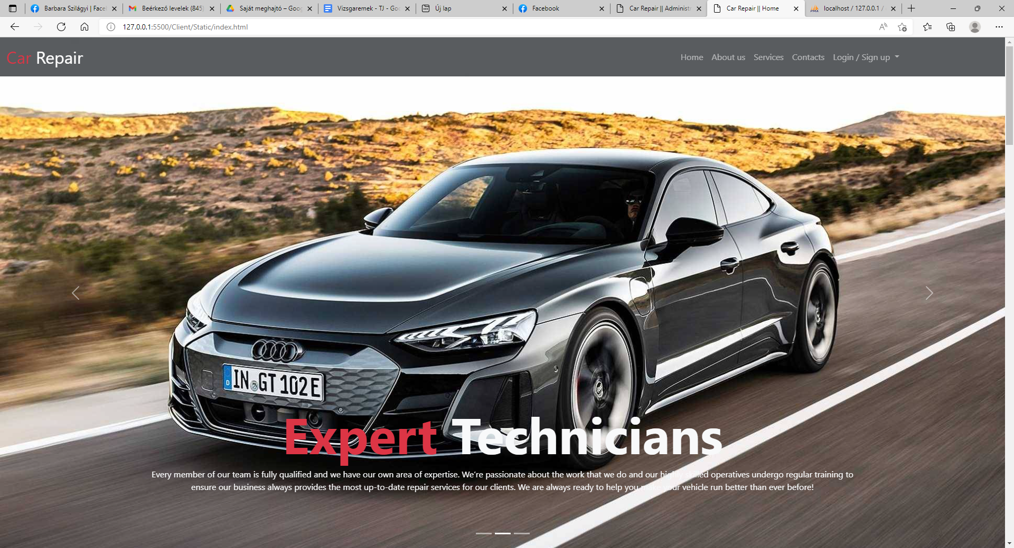
The Landing Page
This is how the site welcomes us. There are 5 menu items in the header: Home About us Services Contacts Login/ sing up . The contact menu item takes you to the bottom of the page where you can find the contact details of the service. The about us menu item shows you what you need to know about the service. The service menu gives you a list of services. Under login /sign up you can choose to log in or register.Translated with www.DeepL.com/Translator (free version)

Slide 4


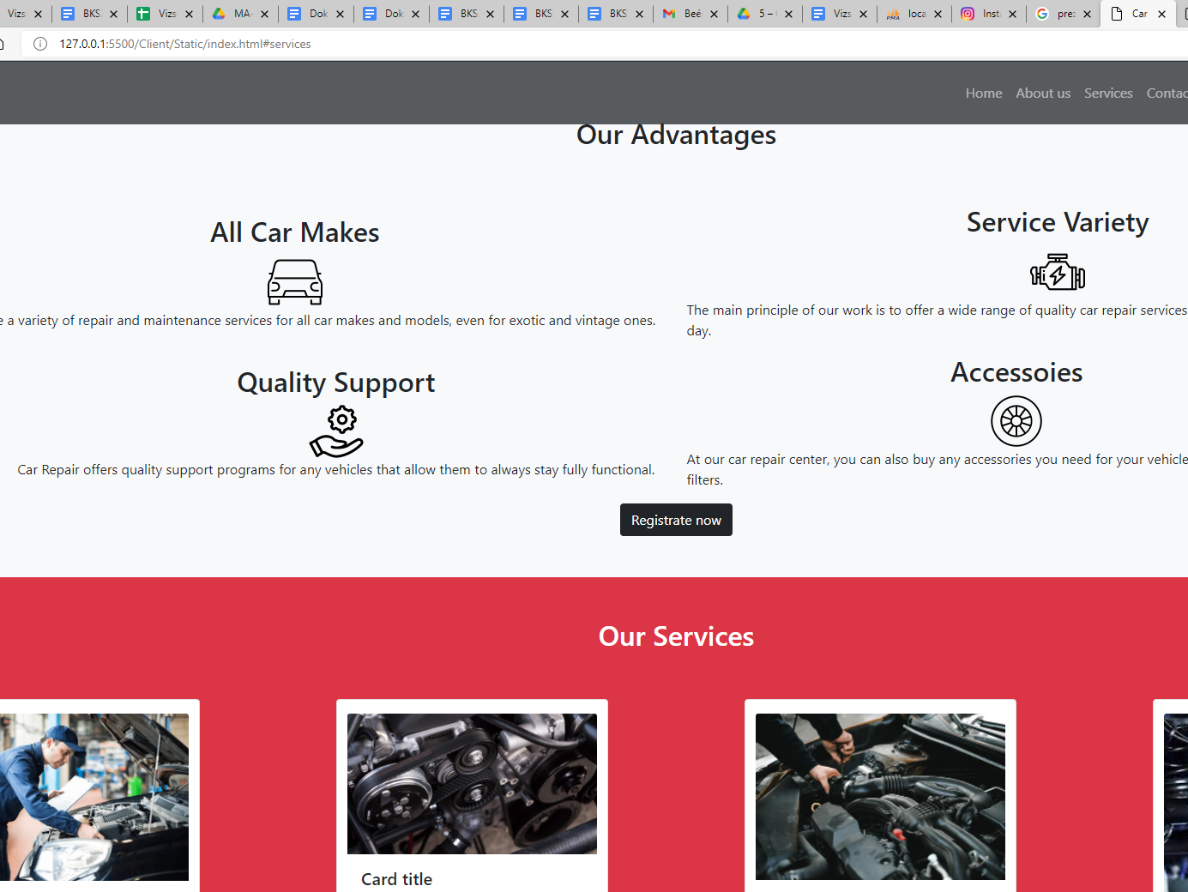



Service menu
Customers can find out more about our services.

Slide 5
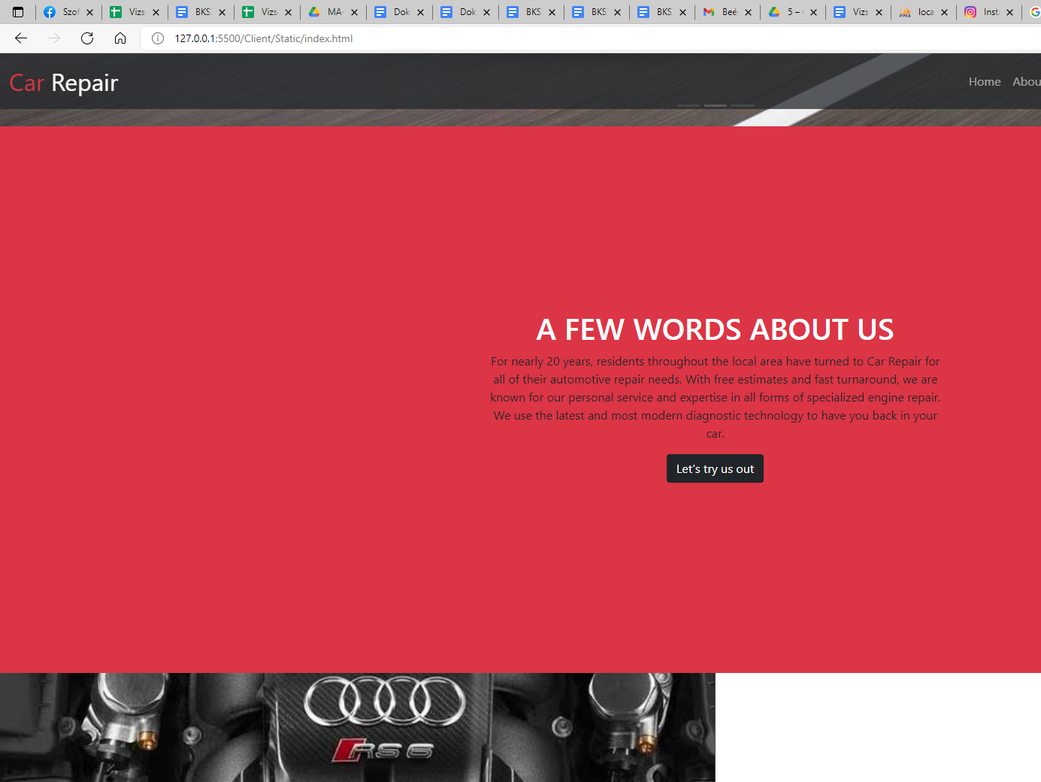
About us
Here the customer receives information about the activities of the service.

Slide 6
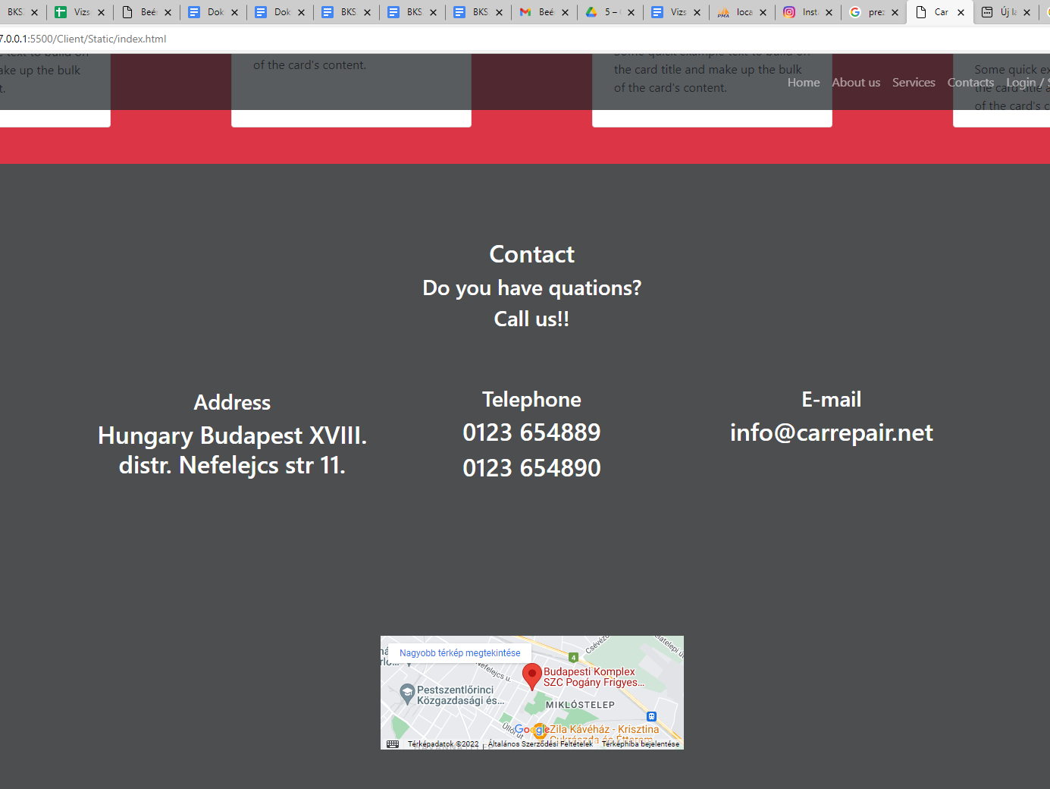
Contact
Here the customer receives information about the activities of the service.

Slide 7
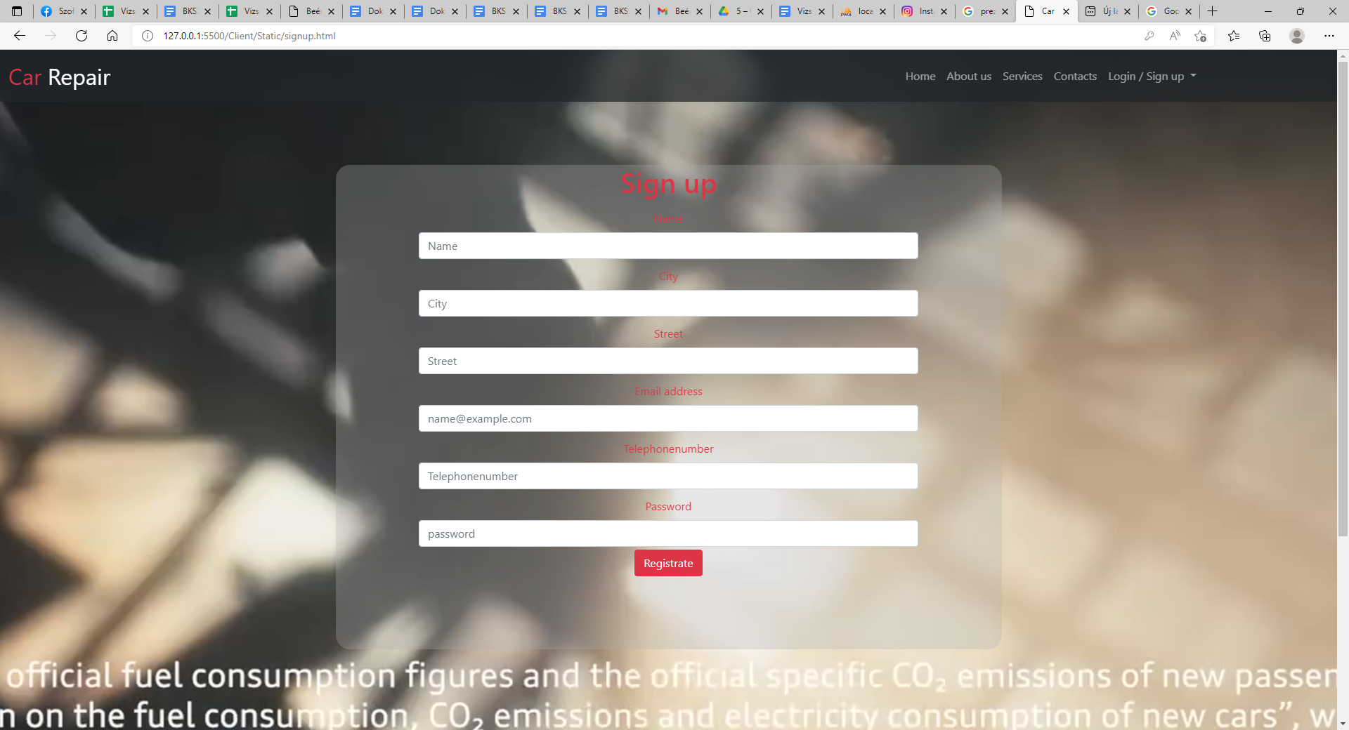
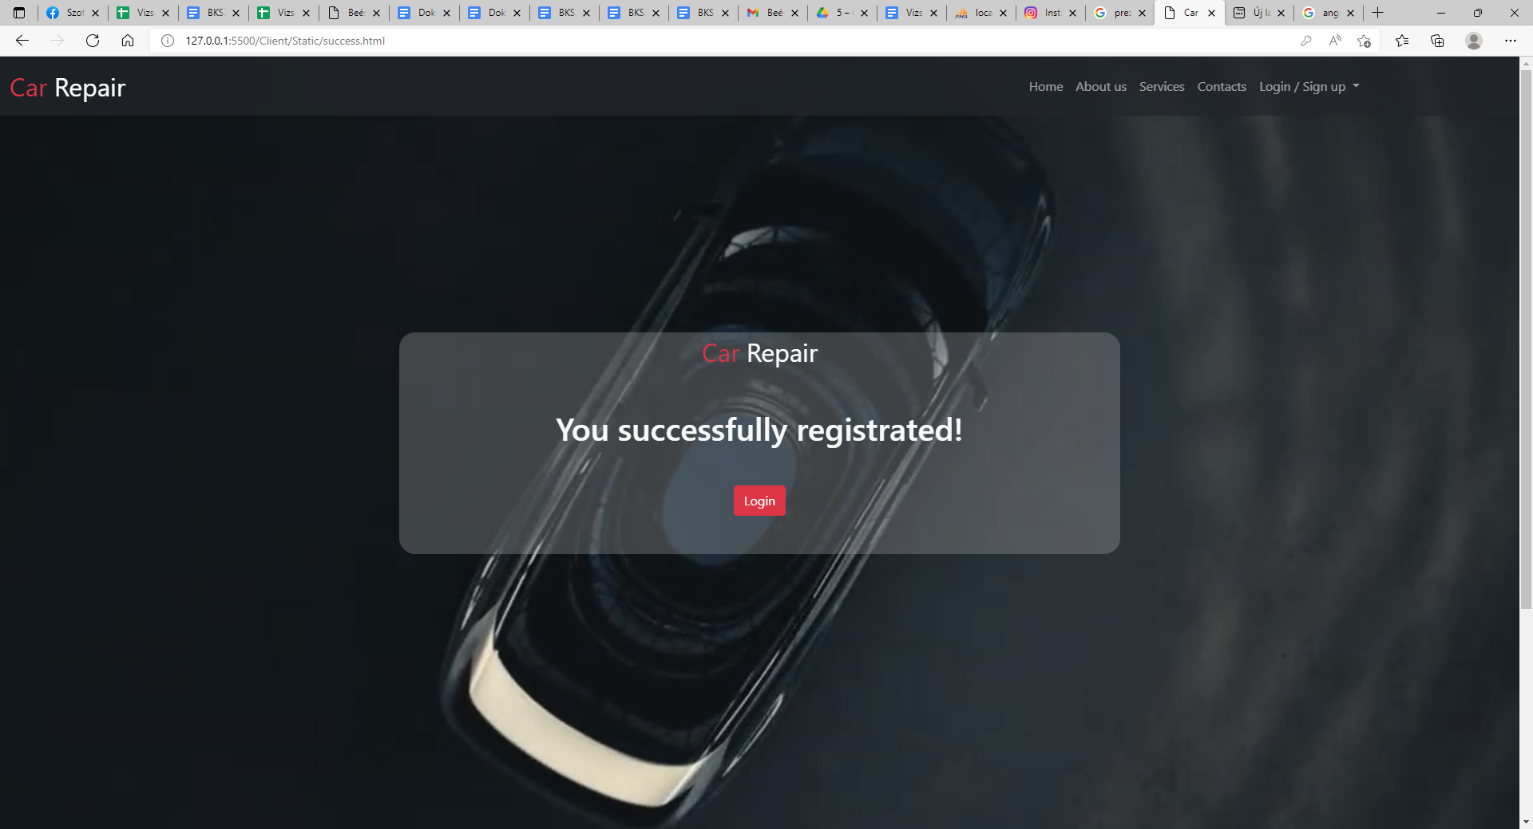
Sign up
You can use our services by registering with your personal data. You will need to provide the following information: name, city , street , e-mail address, phone number, and a password. If you have successfully registered you will be redirected to another page that will show you that your registration was successful. After successful registration we will be offered a login button if we press it we will be redirected to the login interface

Slide 8
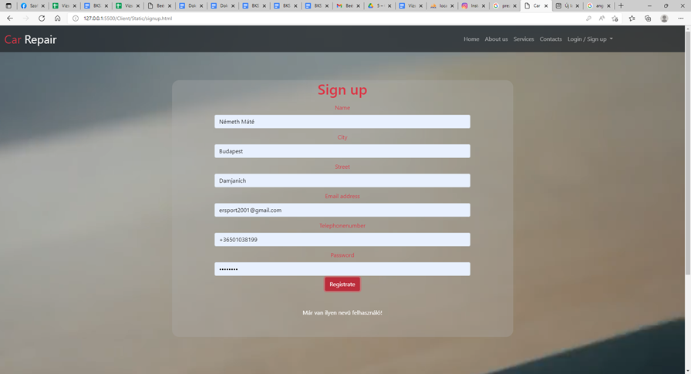
You are allowed to register a person only once. If the customer has already registered and tries to register again, the text will be displayed: This user already exists.

Slide 9
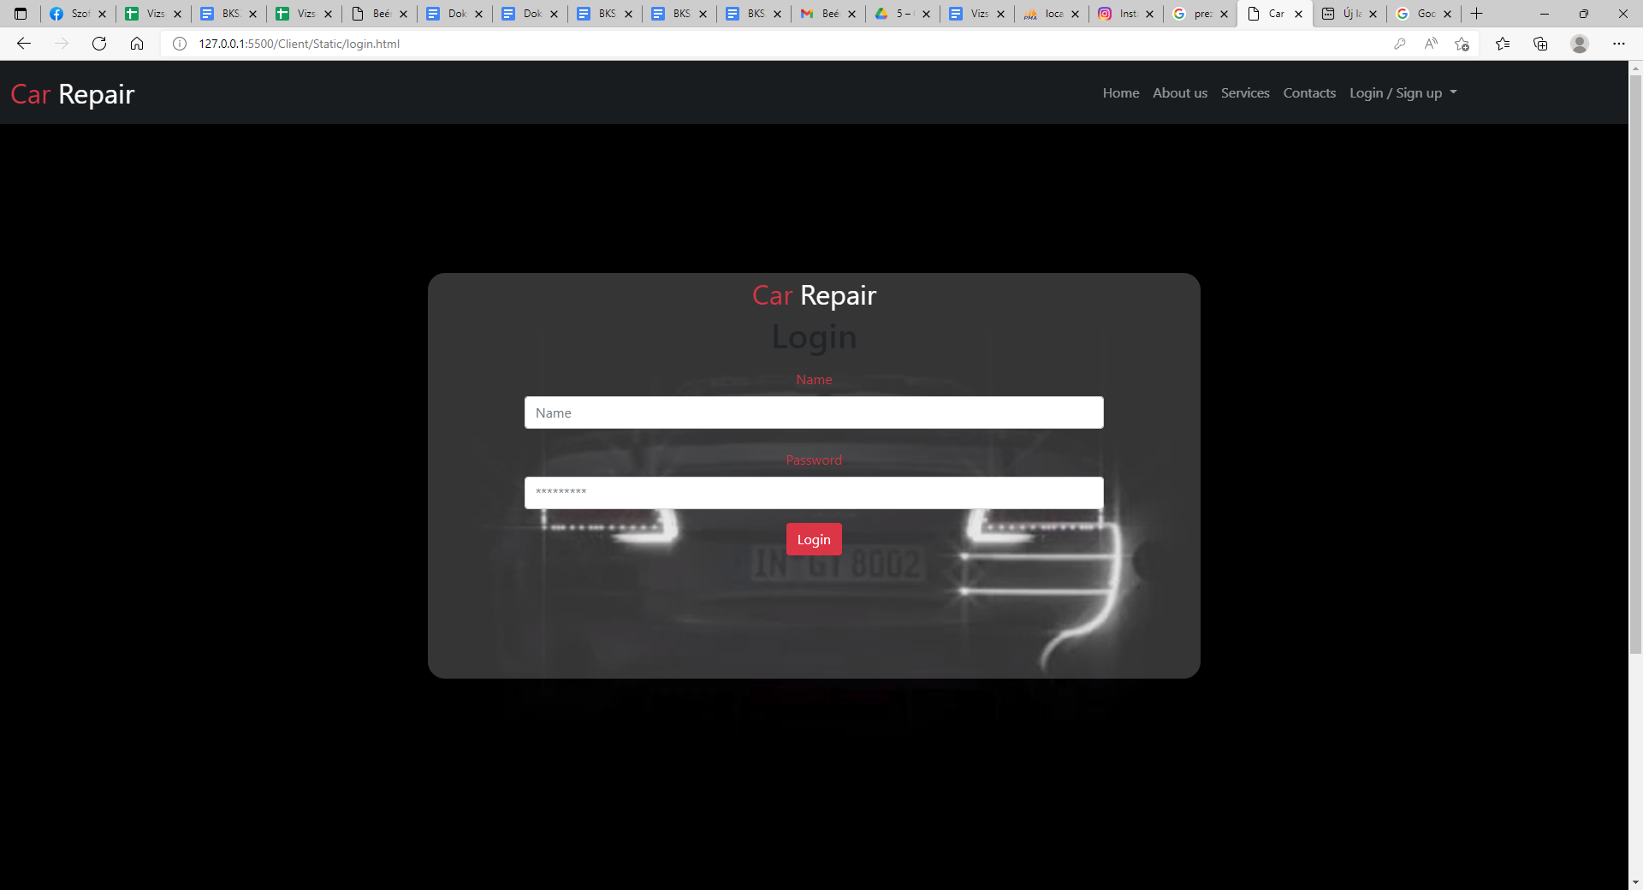
Login
You can log in to the login interface by entering your name and password. If you enter the wrong username, you will see a message saying that no such user exists. If you enter the right username but the wrong password, it will say Incorrect password.

Slide 10
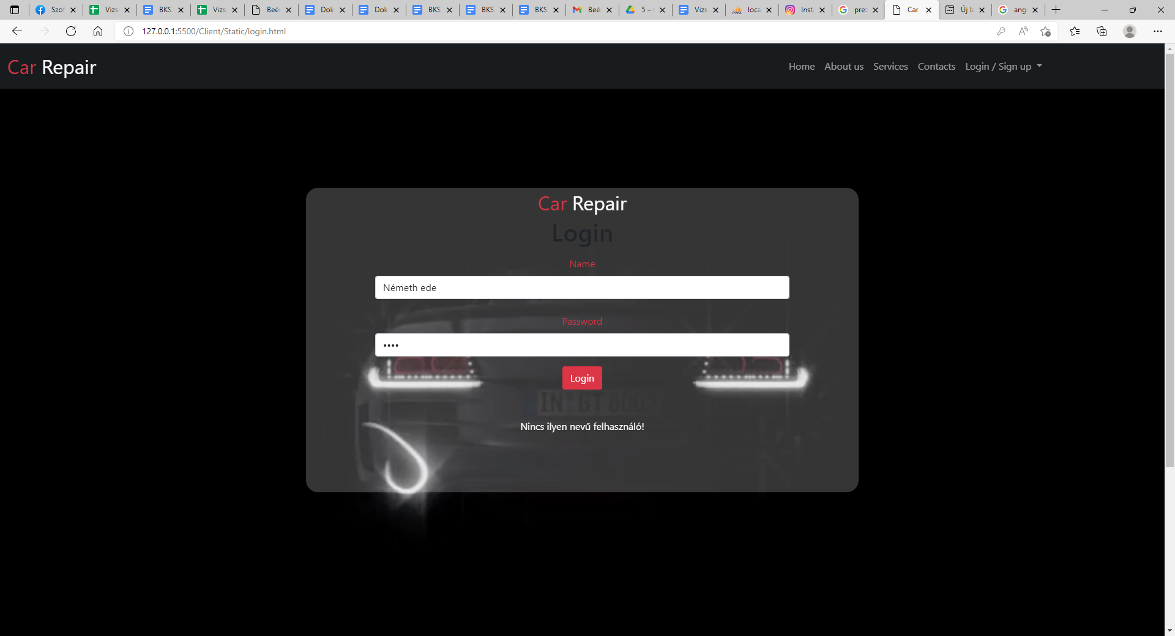
Here is an example of a bad username.

Slide 11
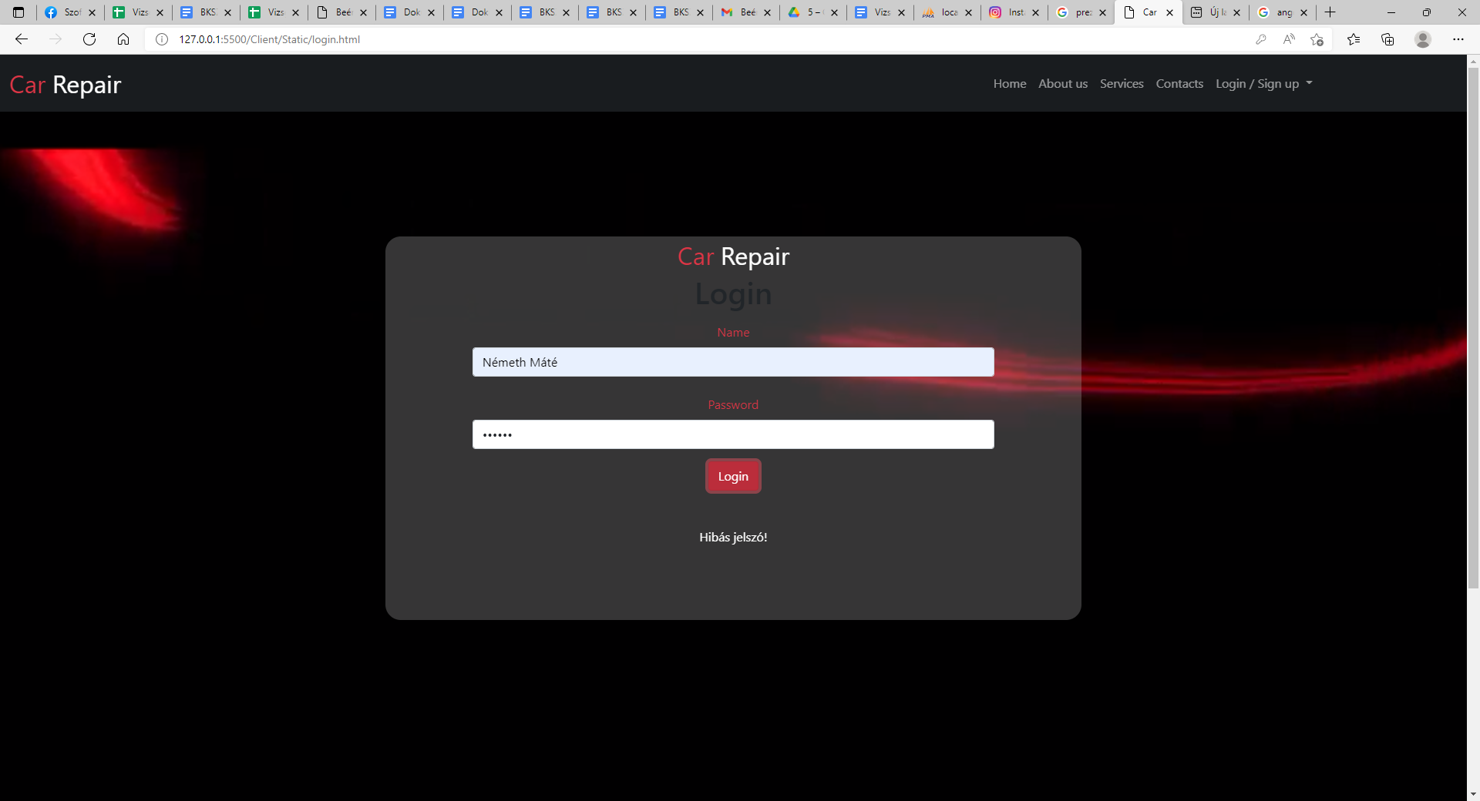
Here is an example of a bad password.

Slide 12
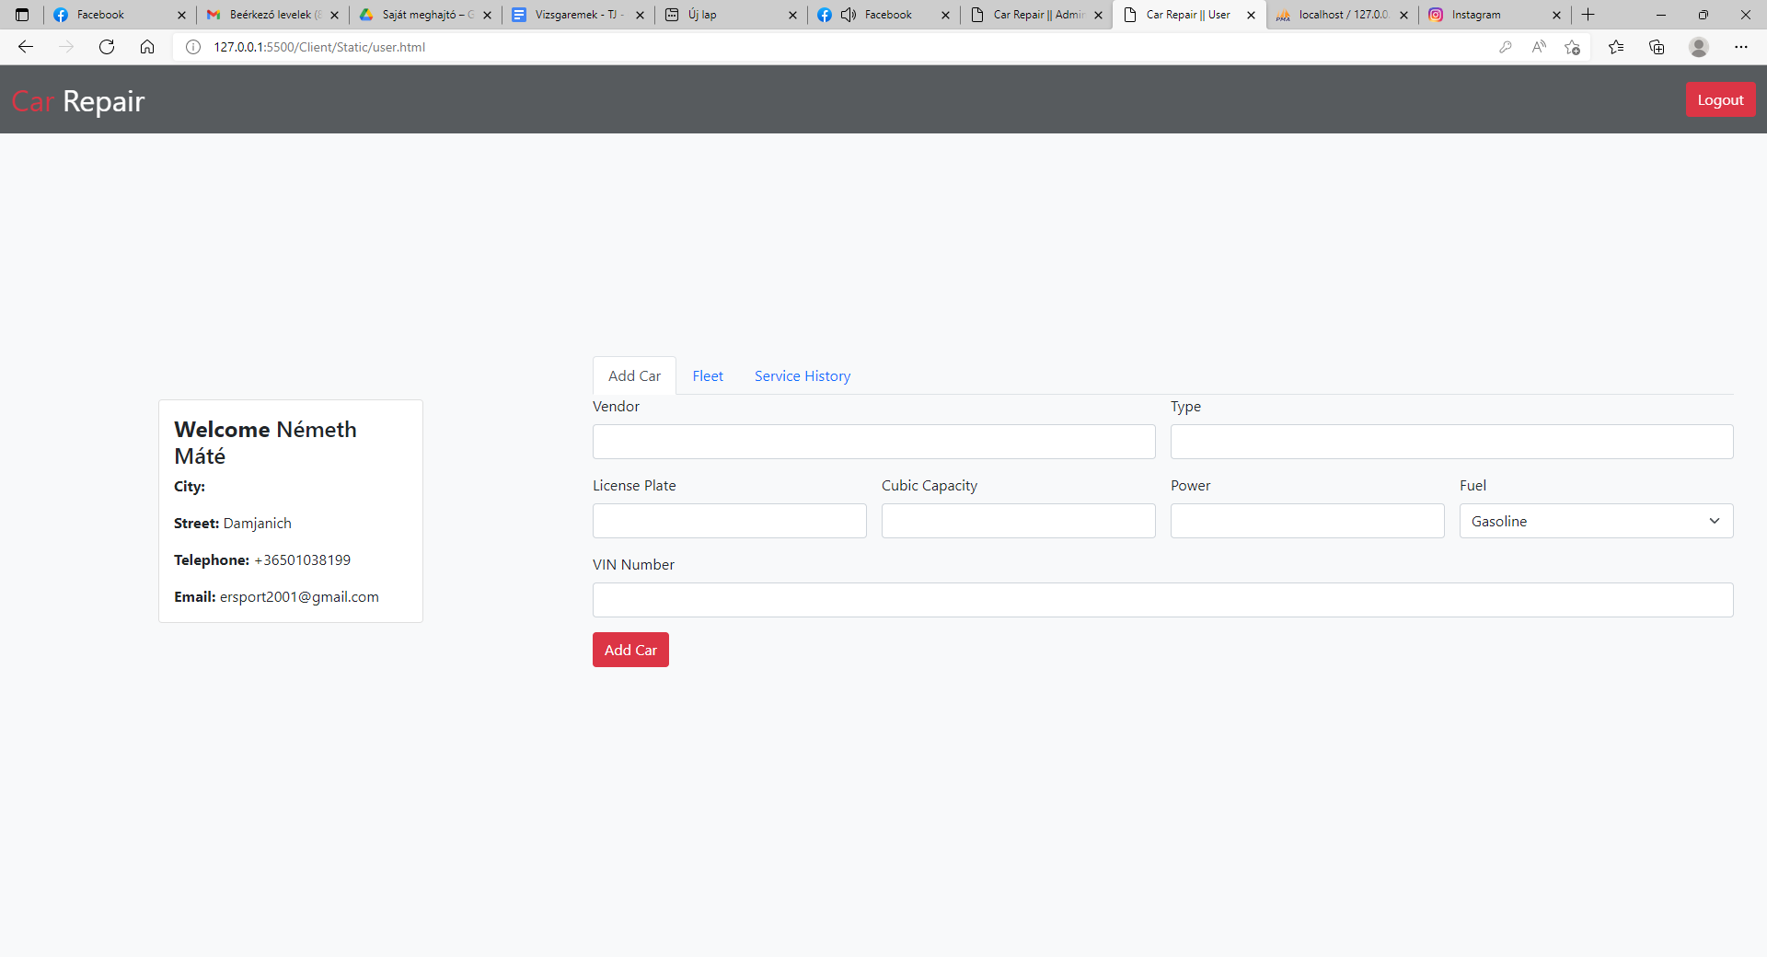
If you have successfully logged in, you can bet on this.
On the left side you will see an image that welcomes the customer and asks for their personal details. If the customer wants to have a car repaired, the first thing to do is to enter the type of car, its registration number, the number of passengers it can carry, its power, the type of fuel and the chassis number.

Slide 13
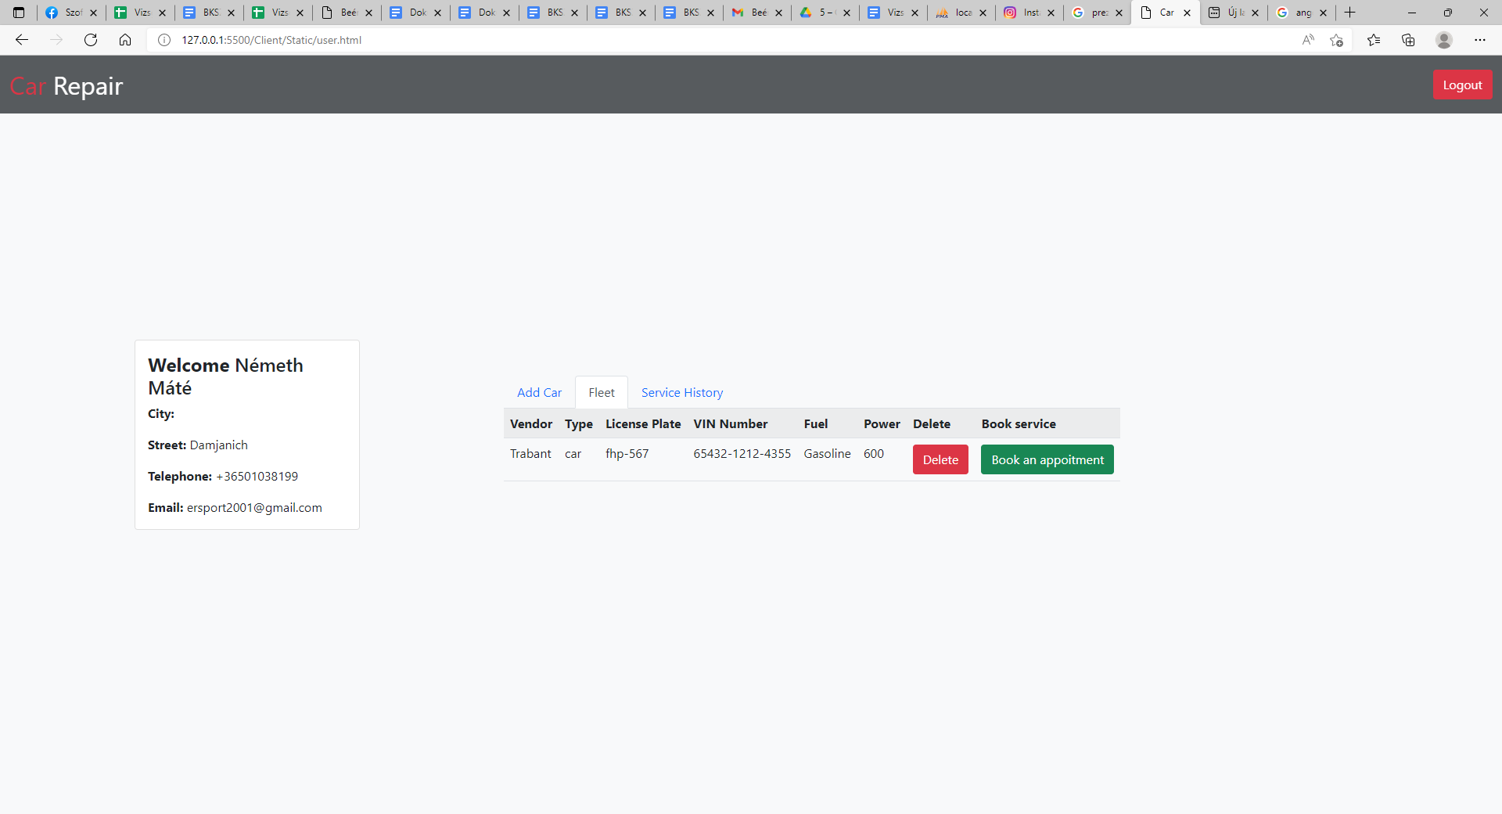
When the customer is ready to register, they can check their details in the fleet menu. Book an appointment with gren button.

Slide 14
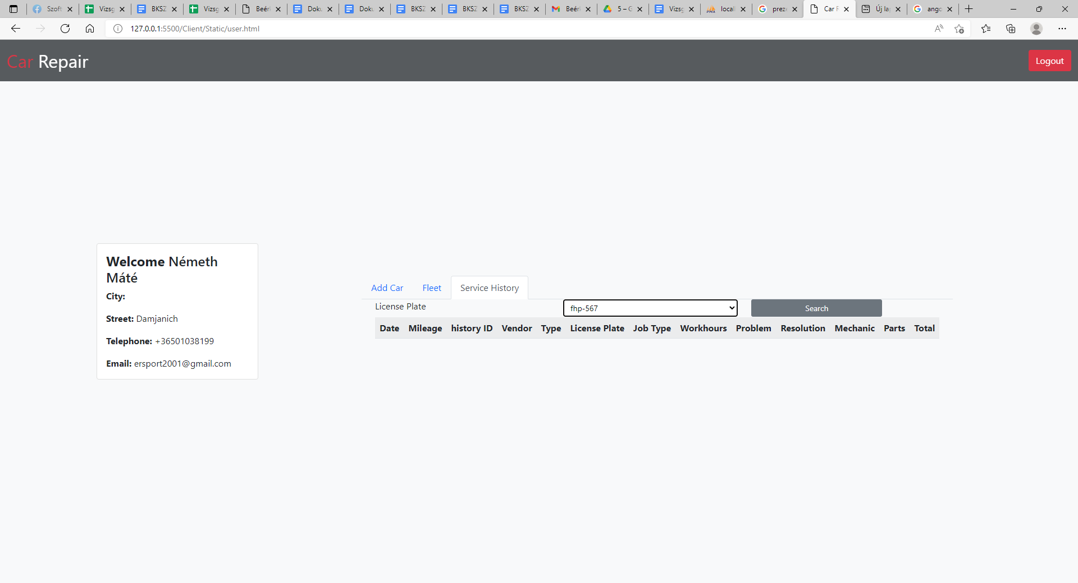
In the service history menu, the customer can retrieve the repair history of his/her car by its registration number.

Slide 15
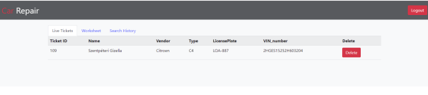
When the technician enters the admin interface then the use ticket menu will still receive the unclosed worksheets and their details. And with the Delete button we can delete the unclosed worksheet. You can see the following data: ticket id,name,make,type,number plate,chassis number.

Slide 16
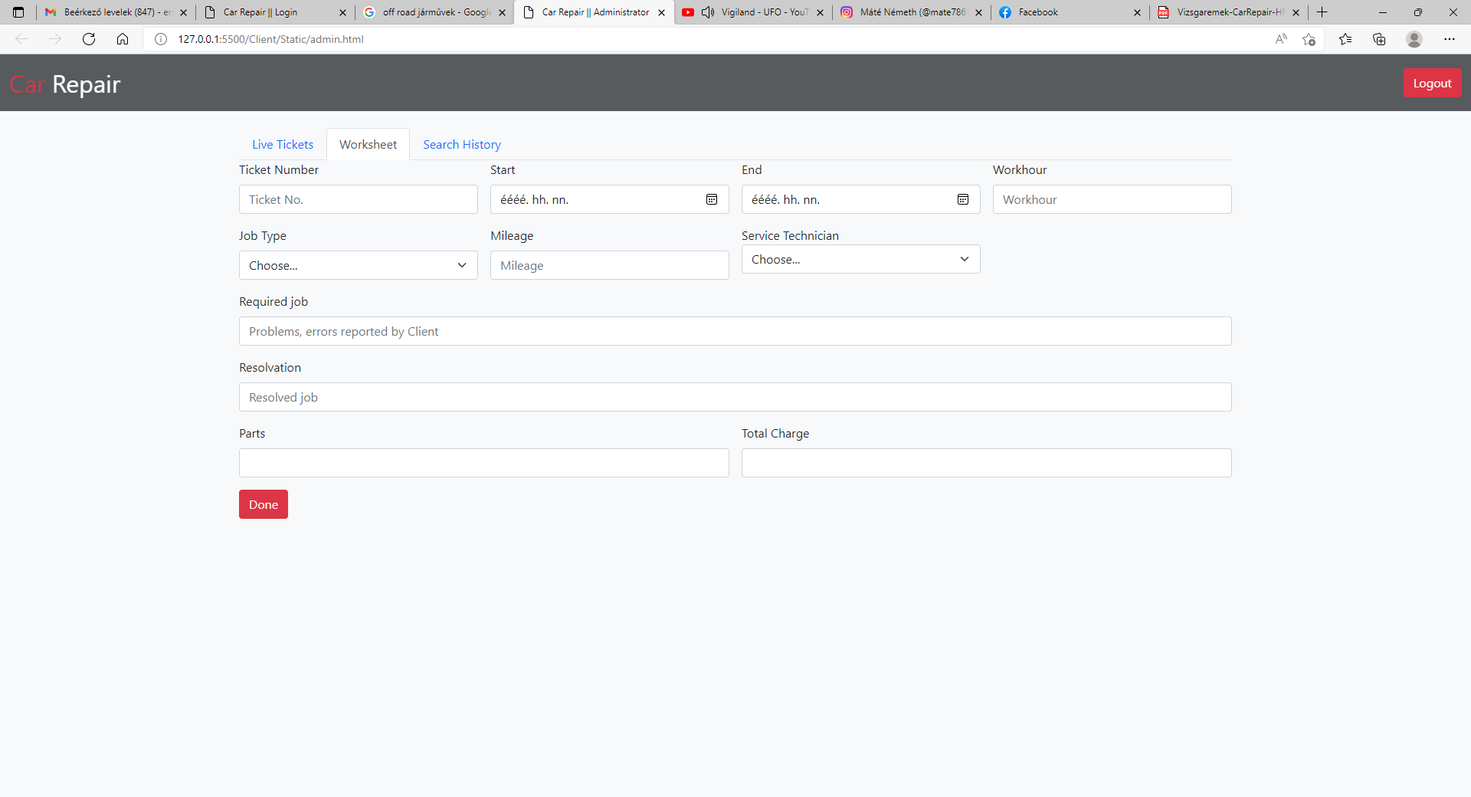
In the worsheet, the mechanic can document the car's faults, the time spent, the labour costs, the name of the person who did the work, a list of any parts replaced.

Slide 17
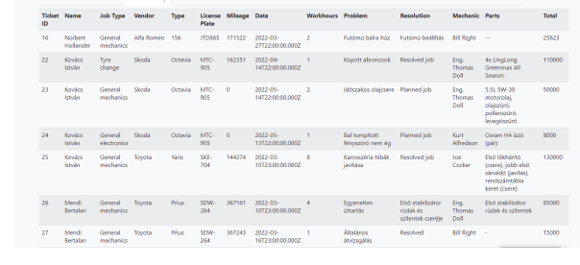
Here, technicians can check back on completed work.

Slide 18
Thank you for your Attention!

